Slide 1

Green Pace
Security Policy Presentation
Developer: Braxton Morrow

Slide 2

OVERVIEW: DEFENSE IN DEPTH
Multi-Factor Authentication is the ability to use an outside application (an authenticator), to authorize access to your application via a 6-digit code that changes typically every 30-45 seconds. This applies to Defense-In-Depth as it adds another layer of security to your system.

Slide 3
THREATS MATRIX
This is a chart to better allow developers and other team members to understand the severity and measure the impact that something may have.
Likely (Threats that are very likely to happen) | Priority (Standard with the highest importance)
Low priority (Standard with the least importance) | Unlikely (Threats are not likely to happen)

Slide 4
10 PRINCIPLES
1) Validate Input Data
2) Heed compiler warnings
3) Architect and Design for Security Policies
4) Keep it Simple (K.I.S.S.- Keep It Simple Stupid)
5) Default Deny
6) Adhere to the Principle of Least Privilege
7) Sanitize Data Sent to Other Systems
8) Practice Defense in Depth
9) Use Effective Quality Assurance Techniques

Slide 5
CODING STANDARDS
1. Do not cast to an out-of-range enumeration value
2. Use valid references, pointers, and iterators to reference elements of a container
3. Do not attempt to create a std::string from a null pointer
4. Do not store already-owned pointer value in an unrelated smart pointer
5. Properly deallocate dynamically allocated resources
6. Use a static assertion to test the value of a constant expression
7. Handle all exceptions thrown before main() begins executing
8. Do not alternately input and output from a file stream without an intervening positioning call
9. Do not invoke virtual functions from constructors or destructors
10. Value returning functions must return a value from all exit paths

Slide 6
ENCRYPTION POLICIES
Encryption in rest – Encryption at rest is used to prevent the attacker from accessing unencrypted data by ensuring that the data itself is encrypted when it’s on a disk. To access this data the attacker must find and utilize the encryption key or break through the encryption.
Encryption at Flight – The process of data being encrypted in transit. Typically done when data is being sent back and forth between host and client and you don’t want an attacker to get the information.
Encryption in Use – Encryption in Use, is exactly as it sounds, it allows data to be encrypted as it’s being used. If this gets compromised the rest of the encryption tends to fall apart as your encryption key becomes vulnerable.

Slide 7
TRIPLE-A POLICIES
Authentication – This is where the user is confirmed as a non-attacker and a User who should have some amount of access to your system. Typically done with a Username as Password, also as I said before utilizing Two-Factor Authentication as well sometimes.
Authorization – This is the level of access any given user has access to your system. Level of access includes, read, write, delete, or modify files within a given system. The final level of access is Admin.
Accounting – The process of monitoring what a user is doing with their level of access to the system. Typically used in some kind of log, it will keep track of what, when, and how something was accessed within your system.

Slide 8
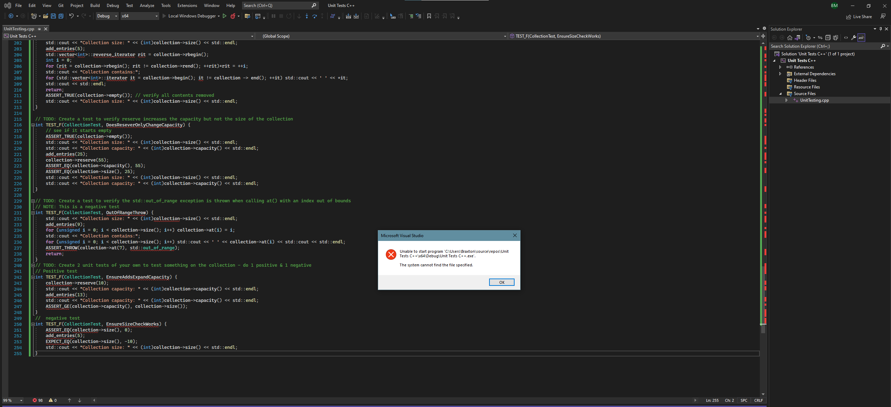
Unit Testing
Two-Factor Authentication, used early and often to ensure quality product this is part of the concept of don’t leave security until the end.

Slide 9

AUTOMATION SUMMARY

Slide 10
TOOLS
The DevSecOps pipeline is a secure coding practice that allows the developers to utilize a full circle approach that is built around keeping code as secure as efficiently as possible. A traditional pipeline has several distinct phases: Plan, Code, Build, Test, Release, Deploy, Operate, and Monitor.

Slide 11
RISKS AND BENEFITS
Well typically there is no benefit to waiting, the faster you act in terms of security (ideally the day code hits an IDE) the better and more secure your system will be. A simple solution that solves your problem eloquently is ideal, also one that you can readily and rapidly use and adapt to a few different situations as the code and the program changes there will be other loopholes that need fixing and patching.

Slide 12
RECOMMENDATIONS
As with every security policy, no system is perfect and there will be gaps. In this case with two-factor authentication the User and the System are both vulnerable to phone cloning. I have a perfect real-life example of this. I have a friend let’s call him “Rabbit” (obviously not his real name similar to a nickname we all call him however), he was a HUUUGGGEEE Old School Runescape player and had a Hardcore Ironman(basically can’t trade with other players) he spent thousands of hours on. He was also known to do some nefarious things such as Duel Arena Gambling (players fight and duel for in game money) on his non-ironman main account, and purchasing in game gold with real USD currency (Against terms of service). He did have a two-factor authenticator setup for his account however, both of them. He apparently won a duel against some less than reputable person, and overnight while he was sleeping somehow that person cloned his phone, got ahold of his authenticator and stole both of his accounts.

Slide 13
CONCLUSIONS
Essentially no system is perfect, however with a solid amount of effort and thought, your system can be hard to get into and potentially not worth the effort of a would-be attacker. Making your system as hard to get into as you can help prevent some things but not everything.

